Slide 1
IDEATE Ambulance controlling system
TEAM MEMBERS :
1.YOKESH.R
2.ZUBAIR ALI.L
3.VISHAL.V

Slide 2
INTRODUCTION:
India is a developing country population of india is significantly growing india stands 2nd place in the world in terms of population ,then there will be increase of vehicle due to which traffic congestion occurs because of which ambulance face diificult to reach the destination.
In addition in recent time the number of deaths due to delays In the arrival of emergency vehicle has risen to a greater extent.
To solve those problems given above ,we have to design a smart ambulance controlling system .the main purpose of this system is to reach a specific location without making it stop somewhere before it reaches the destination.

Slide 3
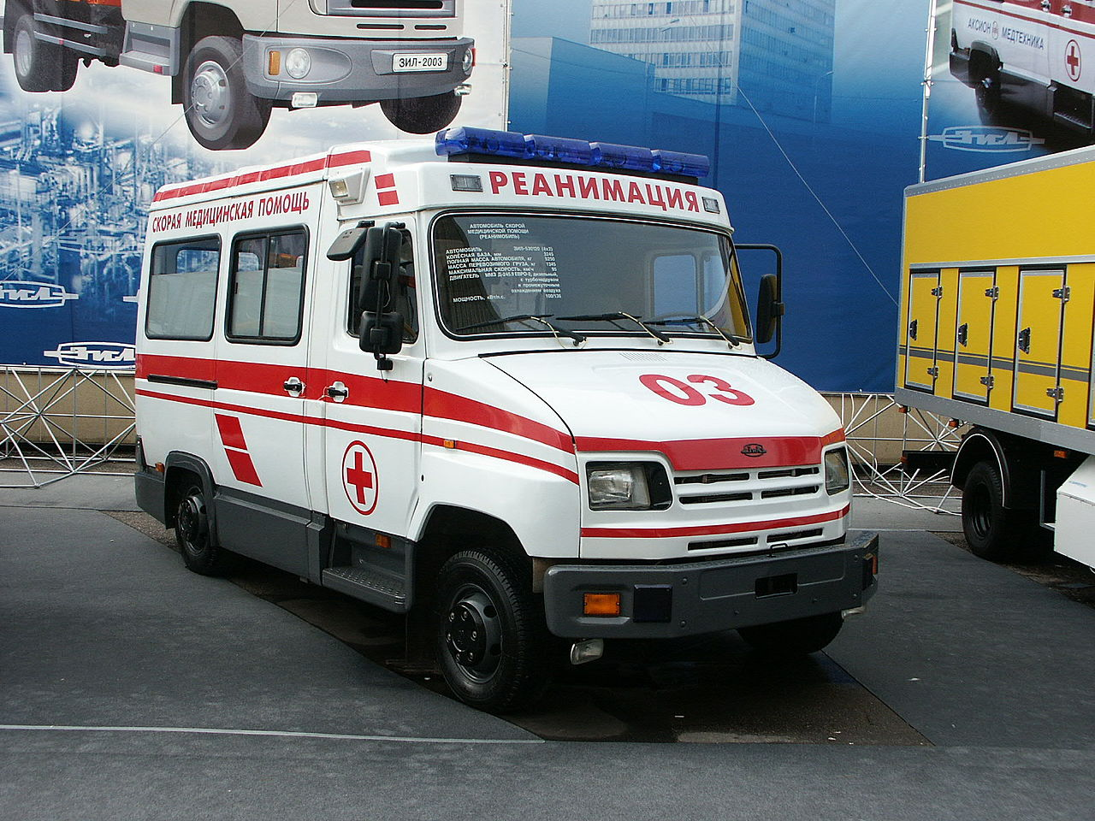

Slide 4
PROBLEM STATEMENT:
We can design a RFID (radio frequency identification) based system which manages and regulates the traffic signals at junctions when the emergency vehicle approaches by allowing the straight forward passage out of traffic congestions .
It controls the traffic signals so that the emergency vehicle is on its way to selected destination .the ambulance can be tracked using gps .
The location is send to an application .the application performs some data and google map .it controls the signal path . We can also introduce a new color light to avoid chaos within the mind of people.

Slide 5
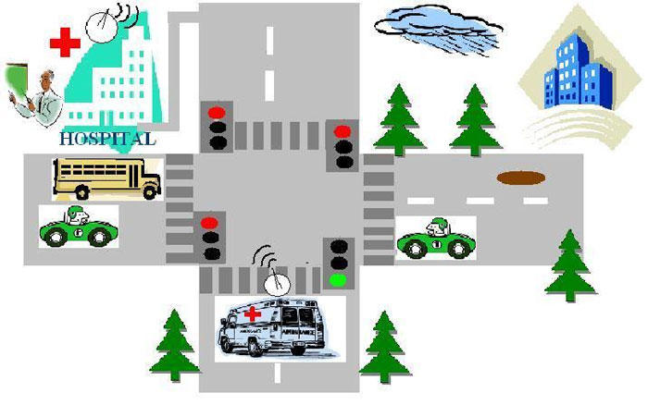
WORKING:
THE WORKING OF THIS SYSTEM RELIES IMPORTANTLY ON TWO MODULES
THE GPS SYSTEM
APPLICATION SERVER
This Photo by Unknown Author is licensed under CC BY

Slide 6
The ambulance or any emergency vehicle must be equipped with the GPS system. The GPS system will send the co ordinates of the vehicle at every moment of application server.
Each vehicle must logged into the android application
The route is already selected by the motive force is accessed by the server
The application server accepts all the details based on this information the server finds this location of the vehicle and also the route selected to the destination.
Wheneever the vehicle comes in space within space of certain meters from the signal server must send some required action so that the vehicle doesnot wait at the signal
A symbol is also additionally sent to the destination hospital authorities are able to handle that patient .hospitals also assign the priority to the patient supported their situation

Slide 7
It is useful when two ambulances arrives to the identical signal at the same time
If the signal is already green it will remain identical as long because the ambulance doesnot glide by
There is also a threat that individuals might think that it is a technical error if it is green for too long on one track and can break the rule
To avoid this we need to introduce a blue colour light placed on the signal so that all understand an emergency vehicle is passing
The android application can be done using IOT by using GSM module and other certain applications to over ride the traditional operation of a stop light
The application also be done with the help of cloud computing

Slide 8
BENEFITS AND OUTCOME :
First and the foremost benefits is to save the life
This system in minimal and cost effective
This system is highly efiicient and economical solution to traffic problems in metropolitian cities in india
This is a straight forward approach to implement ,does not involve a good deal of complex computation ,takes under consideration of parameters and accurately determines average vehicle waiting time.

